Slide 1
PHYS60022 Data Science and Machine Learning for Physics
Week 1: Data Handling and Probability
Spring 2025

Slide 2
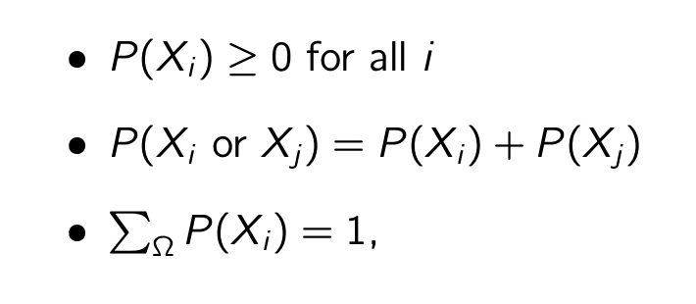
Basics of Probability
We all have an intuitive sense of what probability means. We start by defining the three “Kolmogorov axioms”,
if X_{i} and X_{j} are exclusive
Where P(X_{i}) are probabilities that events/outcomes X_{i} occur and Ω is the set of all possible outcomes → E.G. when rolling an unbiased 6-sided die, Ω={1, 2, 3, 4, 5, 6}

Slide 3
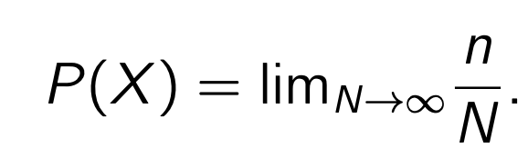
Frequentist Probability
Frequentist (or classical) probability is the definition that you are most likely familiar with.
Consider an experiment with multiple possible outcomes, where one outcome X is desired
For N trials, the desired outcome X is observed n times
The probability that any single event of the N events is given by the limit of the ratio

Slide 4
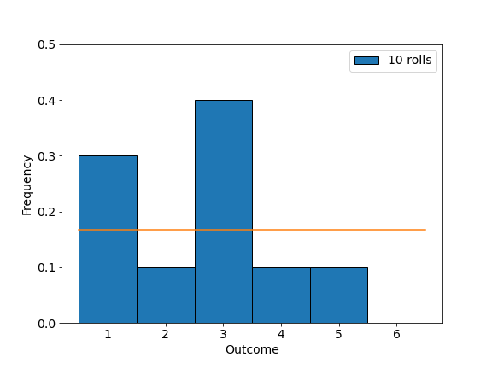
Frequentist Probability
Frequentist (or classical) probability is the definition that you are most likely familiar with.
Consider an experiment with multiple possible outcomes, where one outcome X is desired
For N trials, the desired outcome X is observed n times
The probability that any single event of the N events is given by the limit of the ratio
Example: Rolling a 6-sided die
Ω={1, 2, 3, 4, 5, 6}
1/6

Slide 5
Bayesian Probability
Bayesians think differently about the interpretation of probability.
For physicists we tend to choose the one which is most useful for a given application
If I asked you what you think the probability it will rain tomorrow is, answering that you’d need to repeat “tomorrow” to give me a frequency is not very helpful!
Bayesians avoid this by interpreting probability in terms of a degree of belief something will occur.

Slide 6
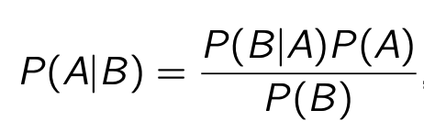
Bayes’ Theorem
The probability that two events A and B occur is given by
Probability that A occurs given that B has occurred
→ Conditional probability
Rearranging gives us Bayes’ rule!
A
A&B
B
Ω

Slide 7
Probability Distributions
We probability distribution describes how often different outcomes of a random variable X will occur
If we have some space of possibilities Ω, then the corresponding probabilities P(X)_{Ω} over all possible values of X ∈ Ω form a probability distribution.
Read as “X is distributed
according to f(X)”

Slide 8
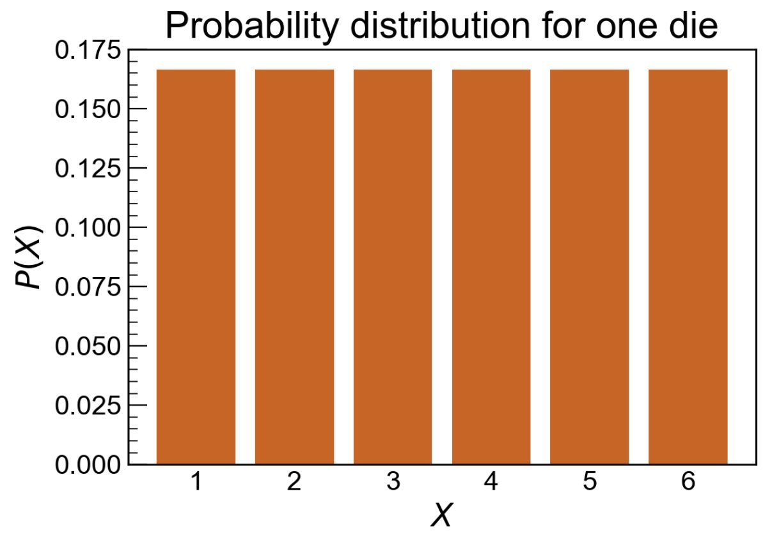
Probability Distributions
We probability distribution describes how often different outcomes of a random variable X will occur
If we have some space of possibilities Ω, then the corresponding probabilities P(X)_{Ω} over all possible values of X ∈ Ω form a probability distribution.
Read as “X is distributed
according to f(X)”
As an example, if X is the outcome of a single die roll, then
Ω = {X = 1, X = 2,X = 3,X = 4,X = 5}
P(X) =1/6 for every possible value of X
The probability distribution is uniform.

Slide 9
Probability Distributions
We probability distribution describes how often different outcomes of a random variable X will occur
If we have some space of possibilities Ω, then the corresponding probabilities P(X)_{Ω} over all possible values of X ∈ Ω form a probability distribution.
Read as “X is distributed
according to f(X)”
As an example, if X is the outcome of a single die roll, then
Ω = {X = 1, X = 2,X = 3,X = 4,X = 5}
P(X) =1/6 for every possible value of X
The probability distribution is uniform.
X in this case is a discrete random variable
→ We call it’s distribution a probability mass function (p.m.f)

Slide 10

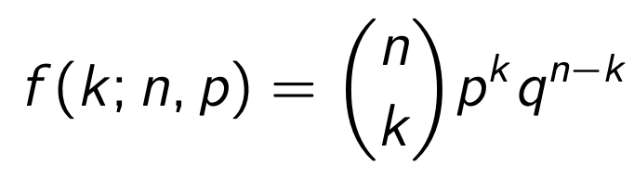
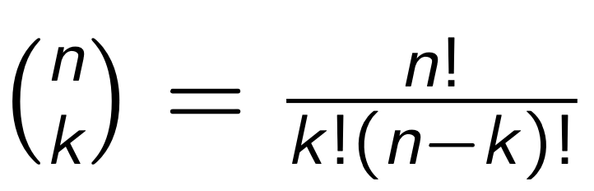
Binomial Distribution
The binomial distribution describes the distribution of the number of successes (k) in a sequence of n independent trials, where the probability of success in any trial is p.
More generally, any sequence of experiments, each of which results in a yes/no, 1/0 or other binary result with probabilities p and q = (1 − p) assigned to each outcome will be described by the binomial distribution,
Observed number of successes k
Distribution f
Parameters of “model” (n, p)

Slide 11
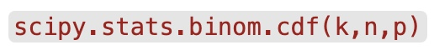
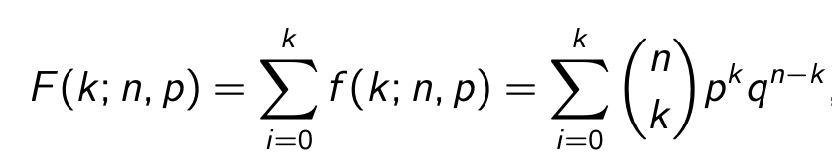
Binomial Distribution
The python package scipy has many of the most common probability distributions available to use
Probability mass function
Cumulative distribution function

Slide 12
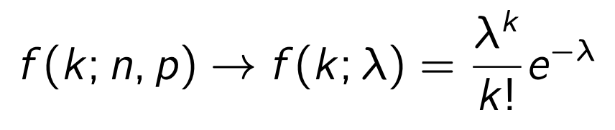
Poisson Distribution
The Poisson distribution is another example of a distribution for a discrete random variable representing counts of events. It is the limiting case of the Binomial distribution when p→0 and N→ infinity
Probability mass function
Cumulative distribution function

Slide 13
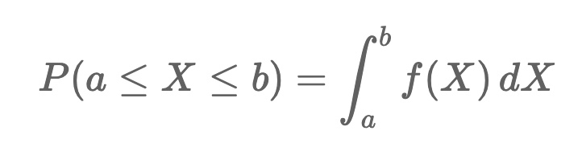
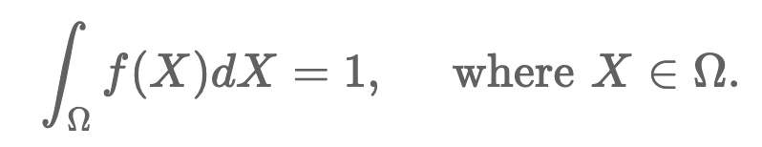
Continuous random variables
Many of the quantities measured in physics are continuous, such as energy or momentum.
When considering values on a continuous scale, it does not make sense to consider defining a probability for a single value; instead, we must define a probability density function.
For some continuous random variable X with probability density function f(X), the probability to find a value of X between a and b is given by,
Our 3rd axiom of probability then requires that

Slide 14
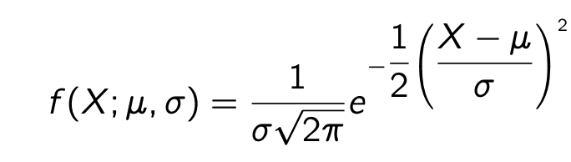
Gaussian Distribution
The Gaussian (or Normal) distribution is the most common probability distribution used in statistics. There is a good reason for this (the Central Limit Theorem) but for now, just to refresh our memories about the Gaussian distribution,
If a continuous random variable X is distributed as a Gaussian/Normal distribution then,
Parameters of the Gaussian probability density function

Slide 15
Gaussian Distribution
Again, scipy has us covered …
Probability distribution
Cumulative distribution

Slide 16
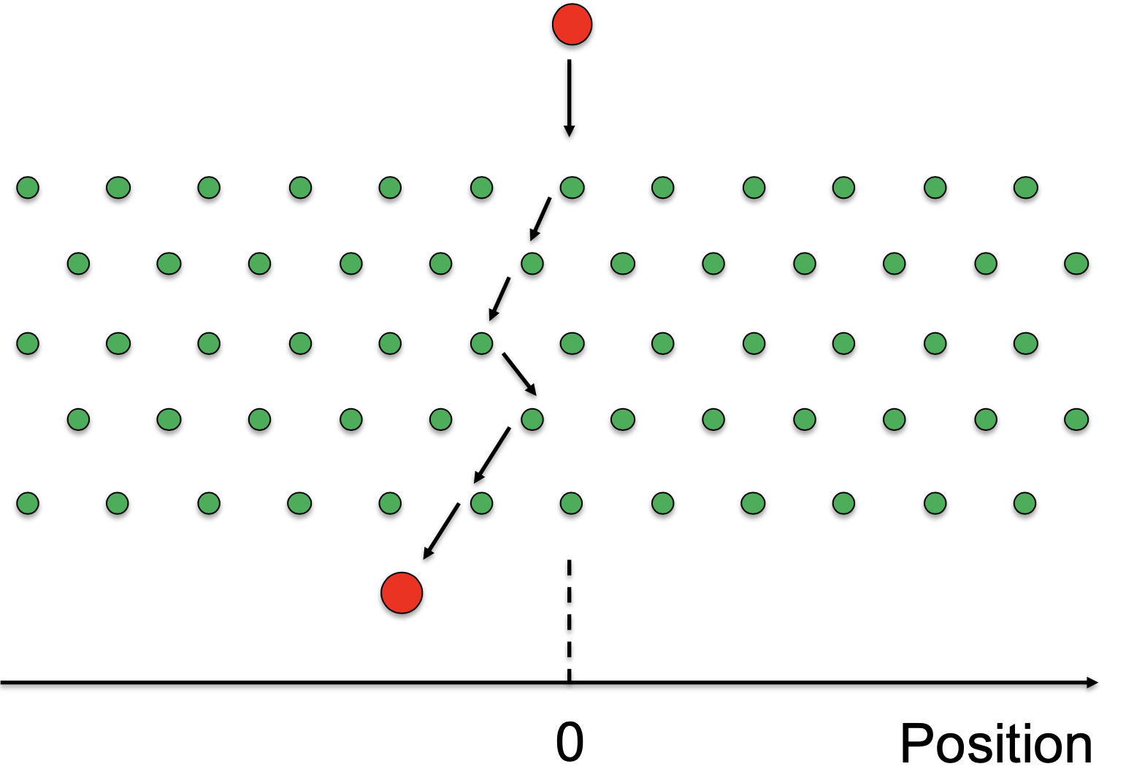
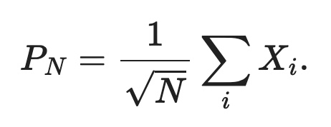
Gaussian Distribution and the CLT
The Central Limit Theorem is what tells us that we should expect to find Gaussian distributions quite often in our data.
Example (Galton Board)
Individual probability distribution for each step is
X_{i} ~ U(-1 or 1) however if we sum, we find a Gaussian

Slide 17
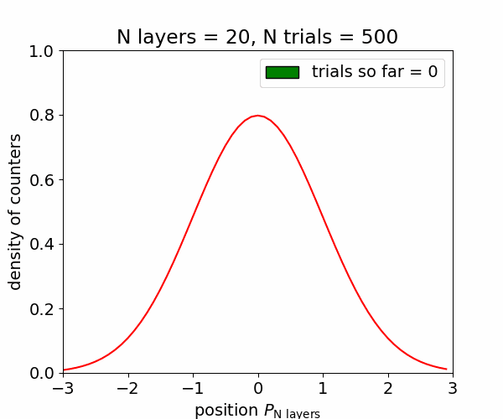
Gaussian Distribution and the CLT
The Central Limit Theorem is what tells us that we should expect to find Gaussian distributions quite often in our data.
Example (Galton Board)
Individual probability distribution for each step is
X_{i} ~ U(-1 or 1) however if we sum, we find a Gaussian
Beware you can’t just apply the CLT everywhere!

Slide 18
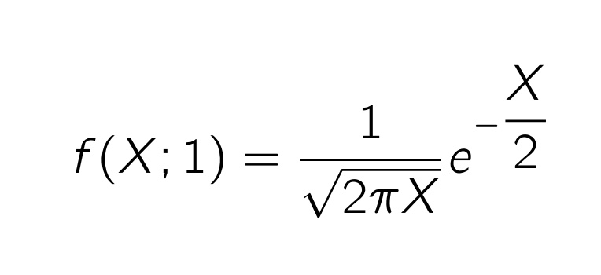
χ² probability distribution
The χ² distribution (pronounced “kai-square”) is related to the normal distribution.
If T ∼ φ(T; 0, 1) then X = T² will be distributed as a χ²(1) - a distribution with 1 degree of freedom,

Slide 19
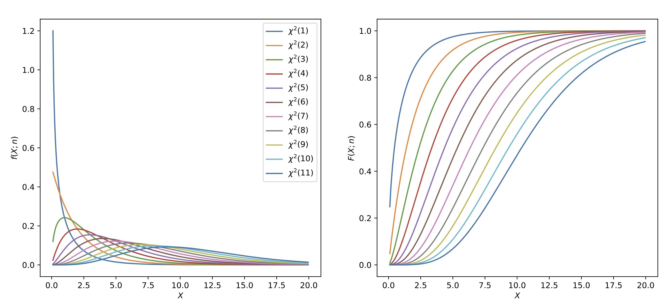

χ² probability distribution
if we have N independent random variables T_{i}, each of which is distributed as a Normal distribution, T_{i} ∼ φ(T_{i}; 0, 1), then their sum
will be distributes as a χ²(N) – with N degrees of freedom

Slide 20
χ² probability distribution
if we have N independent random variables T_{i}, each of which is distributed as a Normal distribution, T_{i} ∼ φ(T_{i}; 0, 1), then their sum
will be distributes as a χ²(N) – with N degrees of freedom
2
This is an example of a composition of random variables
Remember, algebra with distributions of random variables is not the same as with numbers
i.e
Not necessarily equal to

Slide 21
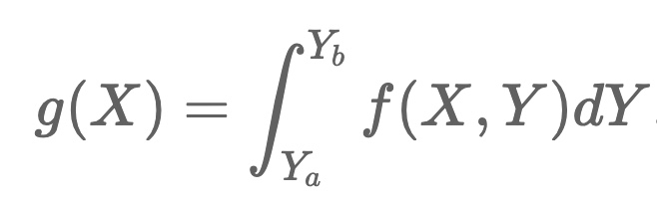
Multivariate probability distributions
As well as probability distributions for single random variables, we can have probability distributions that describe more than one random variable.
We denote the joint probability density function for two random variables X and Y as f(X,Y).
If we want to find the probability density of one of these variables independent of the other, we calculate a marginal density. This is defined as,
where g(X) is the marginal density for the random variable X and Y_{a} < Y < Y_{b}
We say that X and Y are independent if
Note that this is not the same as saying X and Y are uncorrelated

Slide 22
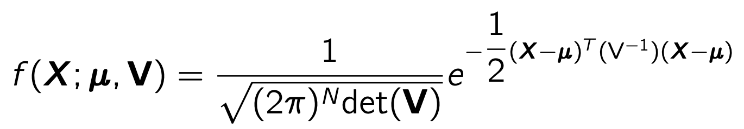
Multivariate Gaussian
A multivariate Gaussian probability density can be written as,
Where X = (X1,X2,X3,...,XN) is a vector of random variables, and V is a N × N symmetric matrix of co-variances Vij = covariance(Xi,Xj).
Eg for N = 2
μ_{X} = 2
μ_{Y} = 7
V_{XX} = 1.5
V_{YY} = 1.0
V_{XY} = 0.85

Slide 23
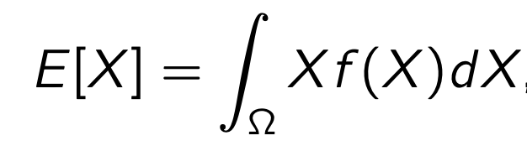
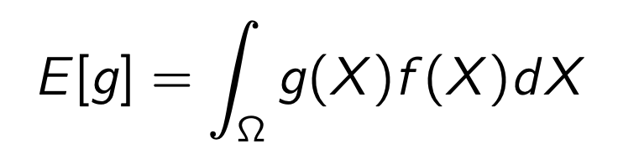
Moments of Probability Distributions
Probability density distributions can be used to obtain useful information about a particular random variable, or functions of random variables. Recall our definitions of Expectation and Variance,
Expectation of a random variable
Sometimes written <X>
any function of X, g(X) has an expectation value E[g] under f (X) of
The expectation is a linear operator
a, b are constant numbers

Slide 24
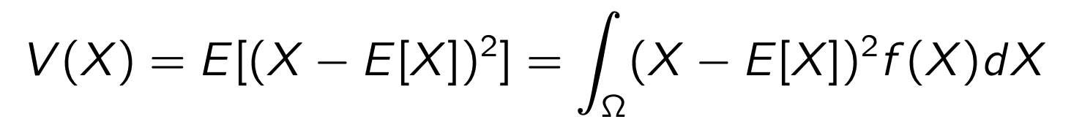
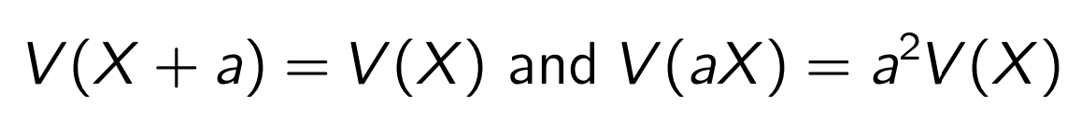
Moments of Probability Distributions
Probability density distributions can be used to obtain useful information about a particular random variable, or functions of random variables. Recall our definitions of Expectation and Variance,
Expectation of a random variable
Variance of a random variable
Sometimes written <X>
any function of X, g(X) has an expectation value E[g] under f (X) of
Variance is not linear, but we do have that
The expectation is a linear operator
“a” is a constant numbers
Higher moments exist, see notebook for details

Slide 25
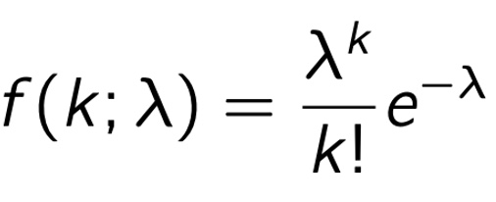
Moments of common probability densities (reminder)
Probability distribution
2

Slide 26
Monte Carlo methods
Shut up and Simulate!
Monte Carlo methods are common where;
Analytic solutions to problems are not feasible (eg. Integrals are intractable)
Practical answers are not possible (eg. Taking real data would take too long/cost too much money)

Slide 27


Monte Carlo methods
Monte Carlo methods are common where;
Analytic solutions to problems are not feasible (eg. Integrals are intractable)
Practical answers are not possible (eg. Taking real data would take too long/cost too much money)
Shut up and Simulate!
We need to simulate/generate stochastic processes to solve these kinds of problems
→ Random number generators to the rescue!
Richard Feynman
David Mermin

Slide 28
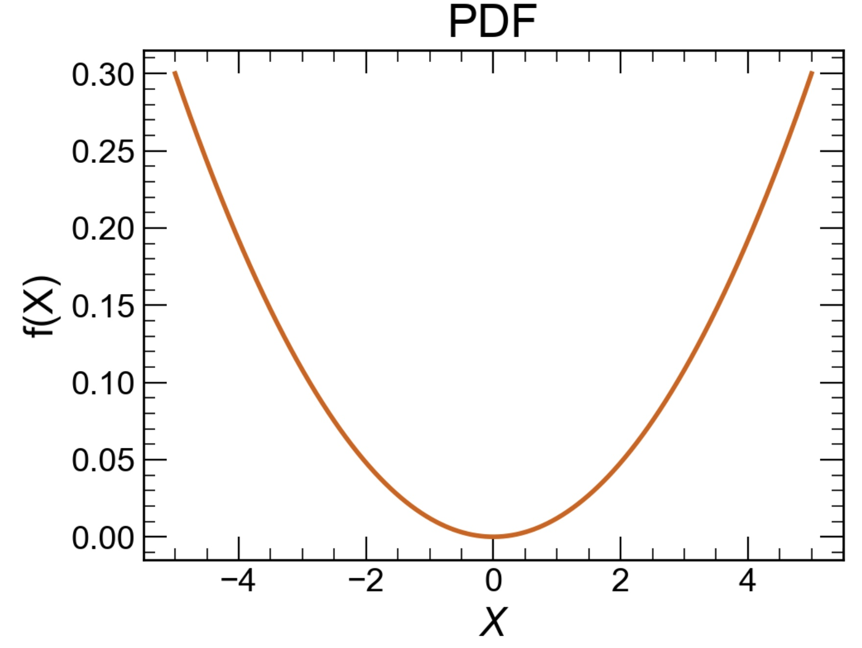
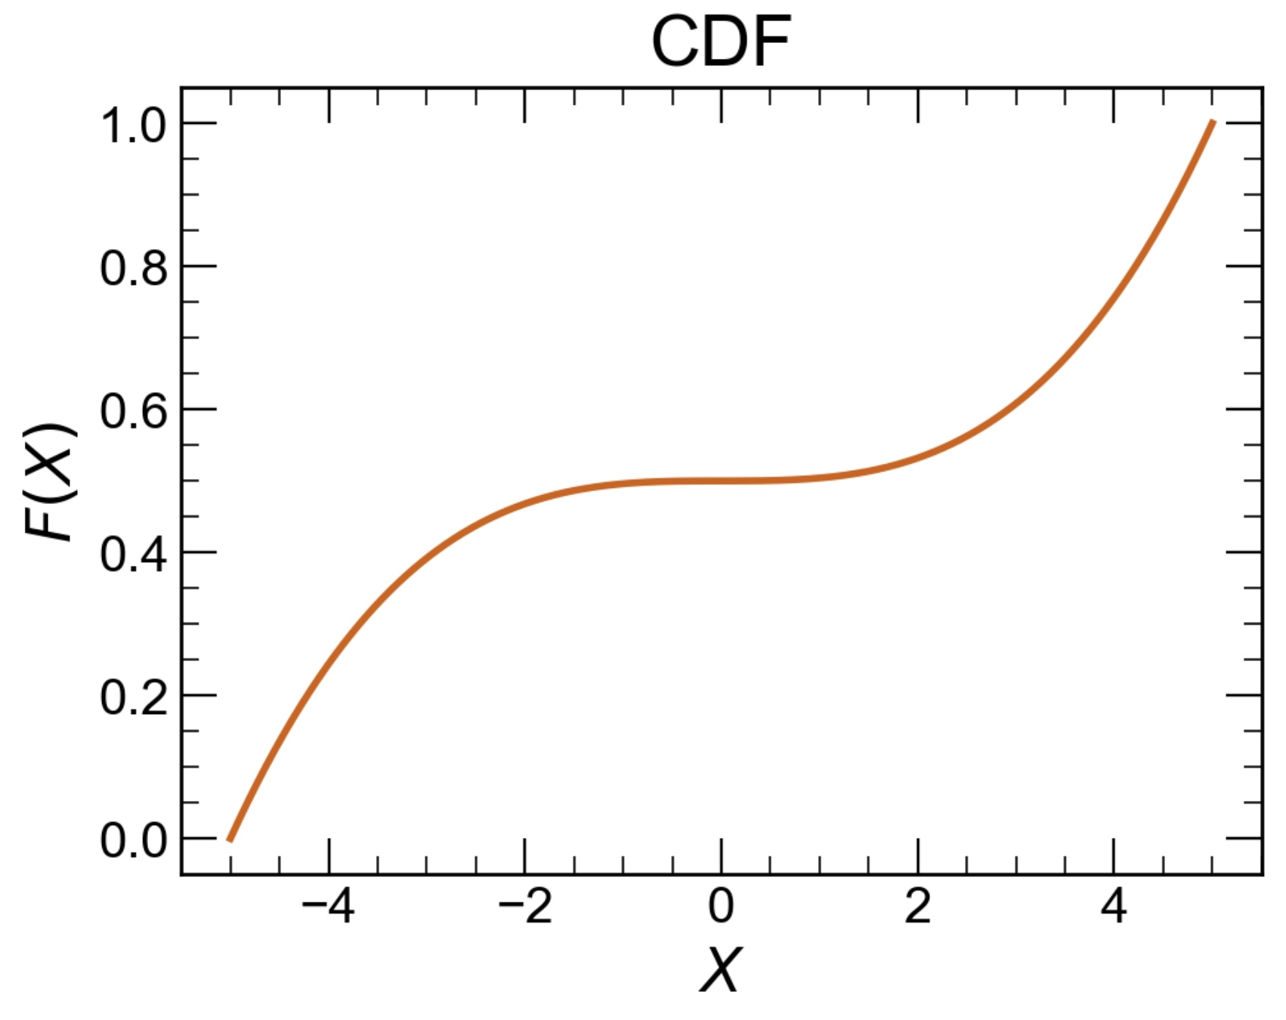
Random Numbers - Inverse Transform
The inverse transform method is one technique to generate random numbers according to a specific probability density function and works as follows,
1. Calculate the cumulative distribution
Shut up and Simulate!

Slide 29
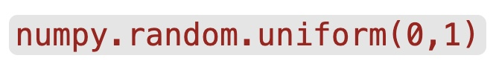
Random Numbers - Inverse Transform
The inverse transform method is one technique to generate random numbers according to a specific probability density function and works as follows,
1. Calculate the cumulative distribution
2. Generate a uniform random number between 0 and 1 (say with )
Shut up and Simulate!
u

Slide 30
Random Numbers - Inverse Transform
The inverse transform method is one technique to generate random numbers according to a specific probability density function and works as follows,
1. Calculate the cumulative distribution
2. Generate a uniform random number between 0 and 1 (say with )
3. Find such that . The distribution of will be
Shut up and Simulate!
You will work through a different method (the accept/reject method) this week
u
F⁻¹ (u)

Slide 31

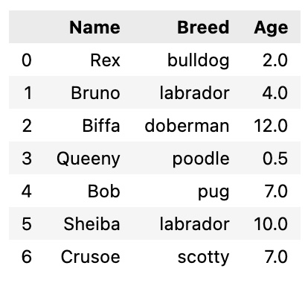
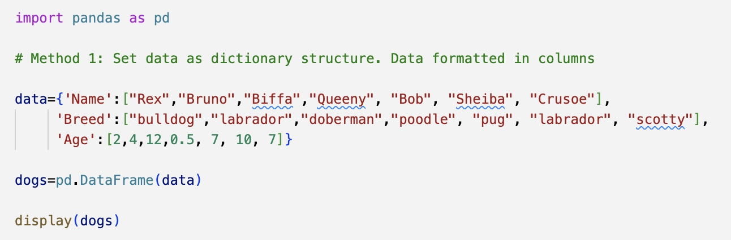
Pandas
Pandas is a well-known, popular library for data manipulation, analysis, and display.
A pandas DataFrame is a tabular structure for data (similar to excel) that are used in many ML/statistics applications.

Slide 32
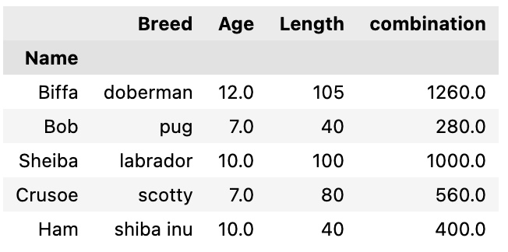
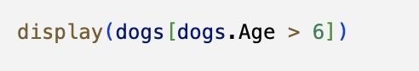
Pandas
There is a lot of built-in functionality to manipulate DataFrames (sorting, indexing, filtering …)
In this week’s notebook, you have some DataFrame manipulation exercises to get started with.

